Slide 1


Entity Framework
SoftUni Team
Advanced Querying
Technical Trainers
Software University
http://softuni.bg

Slide 2


Table of Contents
Executing Native SQL Queries
Selection with anonymous objects
Joining and Grouping Tables
Changing state of objects
Batch Update and Delete

Slide 3
Table of Contents
Stored procedures
Loading types
Concurrency checks
Cascade deletions

Slide 4
Questions
sli.do #Entity

Slide 5
Executing Native SQL Queries
Parameterless and Parameterized

Slide 6
Executing Native SQL Queries
Executing a native SQL query in Entity Framework directly in its database store:
Example:
ctx.Database.SqlQuery<return-type>(native-SQL-query);
string query = "SELECT count(*) FROM dbo.Employees";
var queryResult = ctx.Database.SqlQuery<int>(query);
int customersCount = queryResult.FirstOrDefault();

Slide 7
Native SQL Queries with Parameters
Native SQL queries can also be parameterized:
var context = new SoftUniEntities();
string nativeSQLQuery =
"SELECT FirstName + ' ' + LastName " +
"FROM dbo.Employees WHERE JobTitle = {0}";
var employees = context.Database.SqlQuery<string>(
nativeSQLQuery, "Marketing Specialist");
foreach (var emp in employees)
{
Console.WriteLine(emp);
}
Parameter placeholder
Parameter value

Slide 8
Selection with anonymous objects

Slide 9
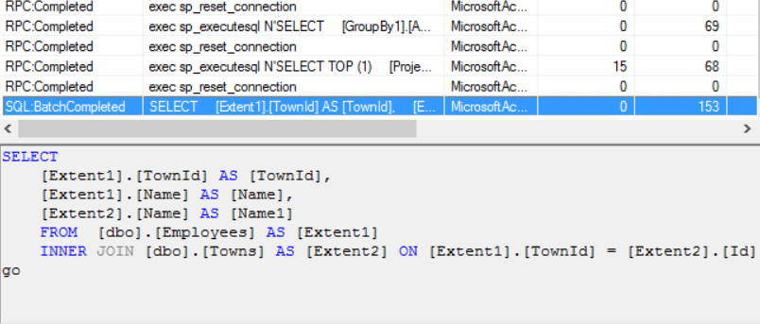
Why use select
Using select, we can take only the data that we need and not all the information from the table. (less traffic)
var employeesWithTown = context.Employees.Select(employee => new
{
EmployeeName = employee.Name,
TownName = employee.Town.Name
});

Slide 10
Why not to use select
Data that is selected is not of the initial entity type, but of an anonymous type that is generated runtime. (a bit more expensive)
Data cannot be modified (updated, deleted), when selected, because we are not working with the actual object, but with a read-only “copy” of it.

Slide 11

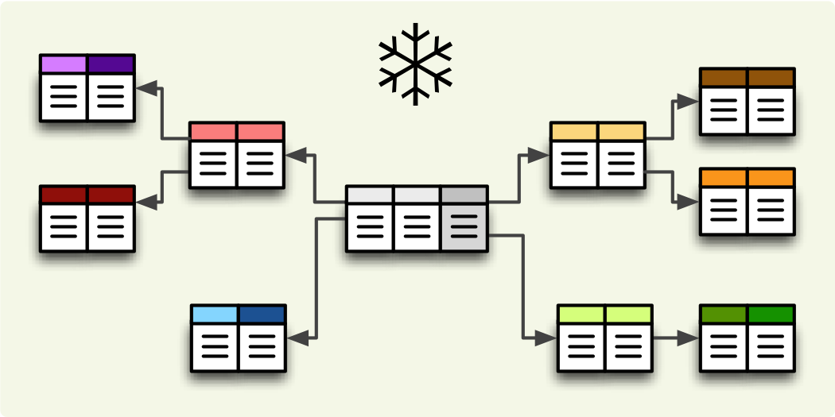
Joining and Grouping Tables
Join and Group Data Using LINQ

Slide 12
Joining Tables in EF
Join tables in EF with LINQ / extension methods on IEnumerable<T> (like when joining collections)
var employees =
from employee
in softUniEntities.Employees
join department
in softUniEntities.Departments
on employee.EmployeeID
equals department.DepartmentID
select new {
Employee = employee.FirstName,
JobTitle = employee.JobTitle,
Department = department.Name
};
var employees =
softUniEntities.Employees.Join(
softUniEntities.Departments,
(e => e.DepartmentID),
(d => d.DepartmentID),
(e, d) => new {
Employee = e.FirstName,
JobTitle = e.JobTitle,
Department = d.Name
}
);

Slide 13
Grouping Tables in EF
Grouping also can be done by LINQ
The same ways as with collections in LINQ
Grouping with LINQ:
Grouping with extension methods:
var groupedEmployees =
from employee in softUniEntities.Employees
group employee by employee.JobTitle;
var groupedCustomers = softUniEntities.Employees
.GroupBy(employee => employee.JobTitle);

Slide 14
Changing state of objects in EF

Slide 15
Attaching and Detaching Objects
In Entity Framework, objects can be:
Attached to the object context (tracked object)
Detached from an object context (untracked object)
Attached objects are tracked and managed by the DbContext
SaveChanges() persists all changes in DB
Detached objects are not referenced by the DbContext
Behave like a normal objects, which are not related to EF

Slide 16
Attaching Detached Objects
When a query is executed inside an DbContext, the returned objects are automatically attached to it
When a context is destroyed, all objects in it are automatically detached
E.g. in Web applications between the requests
You might later on attach to a new context objects that have been previously detached

Slide 17
Detaching Objects
When an object is detached?
When we get the object from a DbContext and then Dispose it
Manually: by set the EntryState to Detached
Employee GetEmployeeById(int id)
{
using (var softUniEntities = new SoftUniEntities())
{
return softUniEntities.Employees
.First(p => p.EmployeeID == id);
}
}
Now the returned employee is detached

Slide 18
Attaching Objects
When we want to update a detached object we need to reattach it and then update it: change to Attached state
void UpdateName(Employee employee, string newName)
{
using (var softUniEntities = new SoftUniEntities())
{
var entry = softUniEntities.Entry(employee);
entry.State = EntityState.Added;
employee.FirstName = newName;
softUniEntities.SaveChanges();
}
}

Slide 19
Batch Update and Delete statements

Slide 20
EntityFramework.Extended
Gives the ability to make a bulk delete of rows/entities by given criteria.
Install EF.Extended as a NuGet package or simply run Install-Package EntityFramework.Extended
Notes:
https://weblogs.asp.net/pwelter34/entity-framework-batch-update-and-future-queries

Slide 21
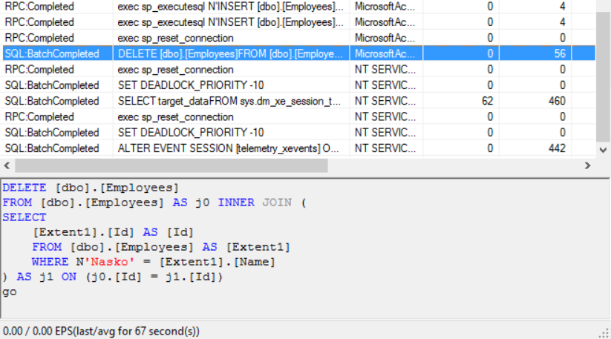
Bulk delete
Delete all users where FirstName matches given string
This results in making only one query for the deletion to the DB
context.Users.Delete(u => u.FirstName == “Pesho");

Slide 22
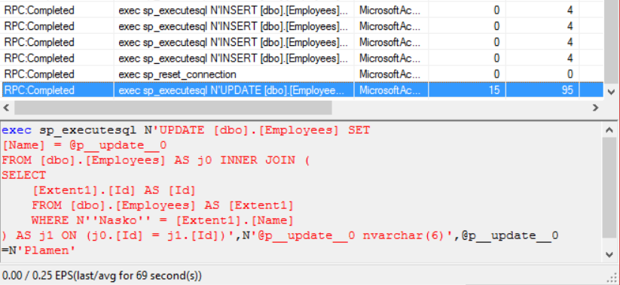
Bulk update without prefilter:
Update all Employees with Name “Nasko” to “Plamen”
This results in making only on query for the update to the DB
context.Employees.Update(
t => t.Name == "Nasko",
t => new Employee() {Name = "Plamen"});

Slide 23
Bulk update with prefilter:
Update all Employees’ age to 99 who have a name “Plamen”
This results in making only on query for the update to the DB like in the previous picture.
IQueryable<Employee> employees = context.Employees
.Where(employee => employee.Name == "Plamen");
context.Employees.Update(
employees,
employee => new Employee() {Age = 99});

Slide 24
Store procedures with EF

Slide 25
Calling a stored procedure
One we have a stored procedure on the server we can call it using the native way of sending queries to the server. We simple need to give the name of the stored proc and the parameters if needed.
Example:
CREATE PROCEDURE UpdateAge @param int
AS
BEGIN
UPDATE Employees SET Age = Age + @param;
END
SqlParameter ageParameter = new SqlParameter("@age", SqlDbType.Int);
ageParameter.Value = 2;
context.Database.ExecuteSqlCommand(
"UpdateAge @age", ageParameter);
Notes:
More information on how tom make stored procedures for Insert, update and delete - https://msdn.microsoft.com/en-us/library/dn468673(v=vs.113).aspx

Slide 26
Loadings

Slide 27
Eager loading
Eager loading is the process whereby a query for one type of entity also loads related entities as part of the query. Eager loading is achieved by the use of the Include method
The Include with the lambdas is found in the System.Data.Entity
IEnumerable<Town> towns = context.Towns.Include("Employees");
OR
IEnumerable<Town> emp = context.Towns.Include(town => town.Employees);
foreach (Town town in towns)
{
Console.WriteLine(town.Employees.Count);
}

Slide 28
Lazy loading
Lazy loading means delaying the loading of related data, until you specifically request for it.
There are some examples (like when using serialization) when we do not want lazy loading. Then we turn it off either by removing virtual or it can be removed for the whole project by:
public CompanyContext()
: base("name=CompanyContext")
{
Configuration.LazyLoadingEnabled = false;
}

Slide 29
Explicit loading
Even with lazy loading disabled it is still possible to lazily load related entities, but it must be done with an explicit call. To do so you use the Load method on the related entity’s entry.
IEnumerable<Town> towns = context.Towns;
foreach (Town town in towns)
{
context.Entry(town).Collection(st => st.Employees).Load();
OR .Reference(st => st.Country).Load();
Console.WriteLine(town.Employees.Count);
}

Slide 30
Concurrency

Slide 31
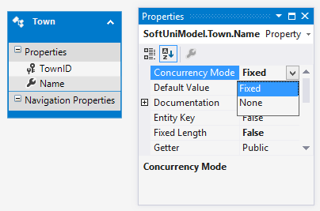
Optimistic Concurrency Control in EF
EF runs in optimistic concurrency mode (no locking)
By default the conflict resolution strategy in EF is "last wins"
The last change overwrites all previous concurrent changes
Enabling "first wins" strategy for certain property in EF:
ConcurrencyMode=Fixed (in DB first project)
[ConcurrencyCheck] (in code first projects)

Slide 32
Last Wins – Example
var contextFirst = new SoftUniEntities();
var lastProjectFirstUser = contextFirst.Projects
.OrderByDescending(p => p.ProjectID).First();
lastProjectFirstUser.Name = "Changed by the First User";
// The second user changes the same record
var contextSecondUser = new SoftUniEntities();
var lastProjectSecond = contextSecondUser.Projects
.OrderByDescending(p => p.ProjectID).First();
lastProjectSecond.Name = "Changed by the Second User";
// Conflicting changes: last wins
contextFirst.SaveChanges();
contextSecondUser.SaveChanges();
Last wins: the second user overwrites the first user's changes

Slide 33
First Wins – Example
var contextFirst = new SoftUniEntities();
var lastTownFirstUser = contextFirst
.Towns.OrderByDescending(
t => t.TownID).First();
lastTownFirstUser.Name = "First User";
var contextSecondUser = new SoftUniEntities();
var lastTownSecondUser = contextSecondUser.Towns
.OrderByDescending(t => t.TownID).First();
lastTownSecondUser.Name = "Second User";
contextFirst.SaveChanges();
contextSecondUser.SaveChanges();
First wins: the second user gets DbUpdateConcurrencyException

Slide 34
Cascade deletions

Slide 35
Cascade delete scenarios
Required FK with cascade delete set to true, deletes everything related to the deleted property
Required FK with cascade delete set to false, throws exception (it cannot leave the navigational property with no value)
Optional FK with cascade delete set to true, deletes everything related to the deleted property.
Optional FK with cascade delete set to false, sets the value of the FK to NULL

Slide 36
Solving Cascade Delete Issue with Fluent API
Two solutions with Fluent API:
Remove default cascade delete convention globally
Manually configure the relation
modelBuilder.Conventions
.Remove<OneToManyCascadeDeleteConvention>();
modelBuilder.Entity<User>()
.HasMany(u => u.Answers)
.WithRequired(a => a.User)
.WillCascadeOnDelete(false);

Slide 37









Advanced Querying in Entity Framework
https://softuni.bg/courses/

Slide 38
License
This course (slides, examples, demos, videos, homework, etc.) is licensed under the "Creative Commons Attribution-NonCommercial-ShareAlike 4.0 International" license
Attribution: this work may contain portions from
"Databases" course by Telerik Academy under CC-BY-NC-SA license

Slide 39





Free Trainings @ Software University
Software University Foundation – softuni.org
Software University – High-Quality Education, Profession and Job for Software Developers
softuni.bg
Software University @ Facebook
facebook.com/SoftwareUniversity
Software University @ YouTube
youtube.com/SoftwareUniversity
Software University Forums – forum.softuni.bg

